Slide 1

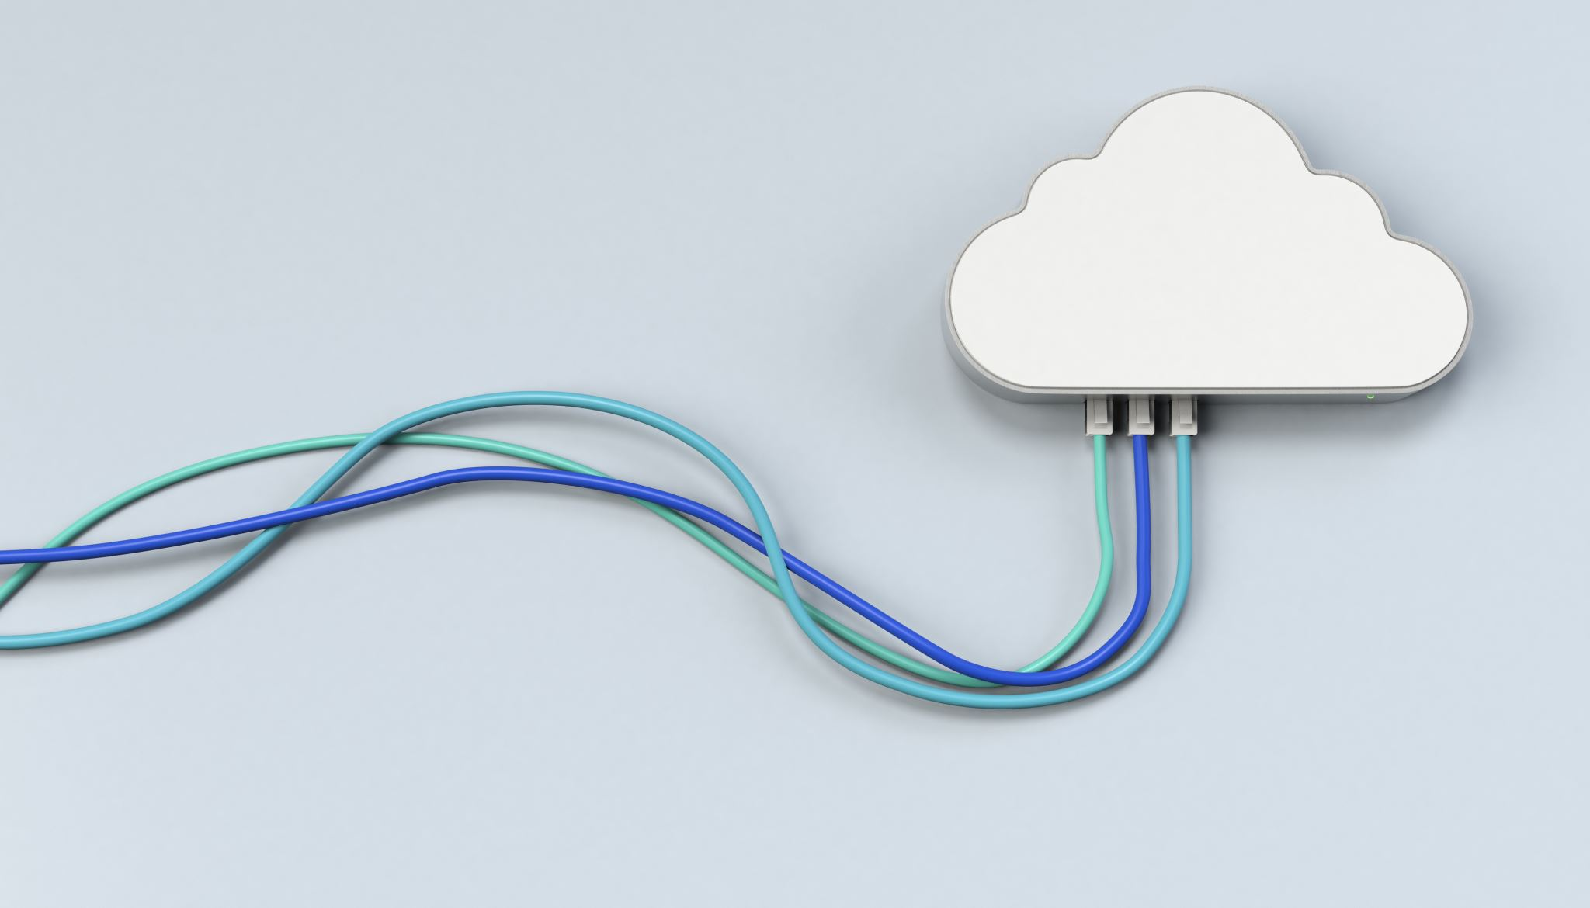
Cloud Computing Lecture 2 Technology Challenges
K. V. Subramaniam

Slide 2
Recall and Review
What are different models of cloud computing?
Give examples of various models
Cloud Computing models
IaaS
PaaS
SaaS
See next slide

Slide 3
A Spectrum of Cloud Models
Amazon AWS
VMs Look Like Hardware
No Limit on App Model
User Must Implement Scalability and Failover
Microsoft Azure
.NET CLR/Windows Only
Choice of Language
Some Auto Failover/ Scale
Force.Com
SalesForce Biz Apps
Auto Scaling/ Provisioning
IaaS: Suited for customers who want control over OS, software and develop application
PaaS: Suited for customers who want to develop application
SaaS: Suited for customers who simply want to use application
Notes:
3

Slide 4
Technology Challenges

Slide 5

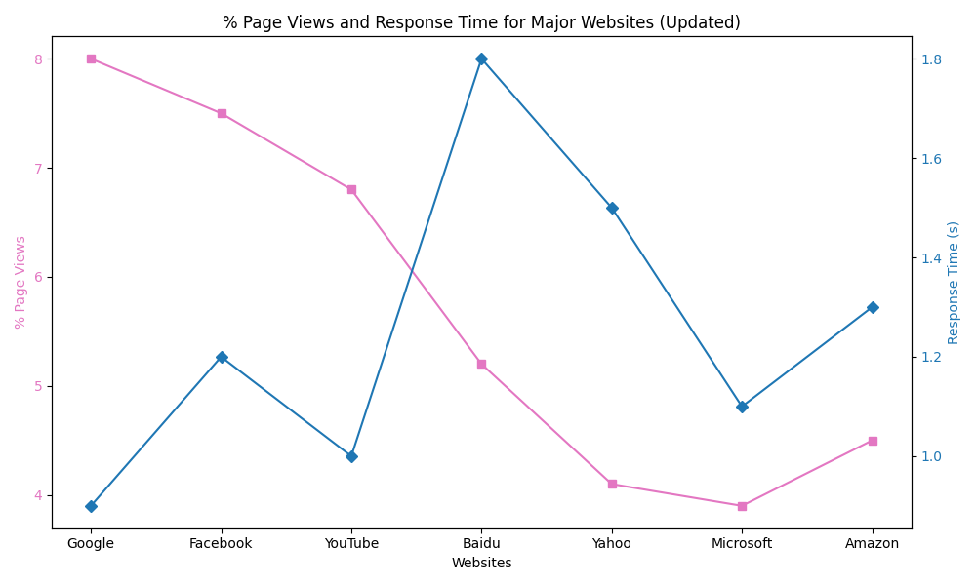



Scalability
Many Web sites have high traffic
Facebook – 7.5%
Google – 8.0%
But they still maintain good response time
Facebook ~1.2 sec
Google ~0.9 sec
Large amounts of storage
Google has many copies of Web. Adds 2.5EB(Exabytes) of storage
Facebook adds ~5PB per day of storage
Notes:
Graph shows the percent page views to many of the popular web sites and the response time that they maintain. It shows that while these sites get lots of hits, they still manage to give a low response time.

Slide 6
Elasticity
How to scale up and down quickly?
Resource allocation and workload placement algorithms are required.

Slide 7
Server
Client

Slide 8
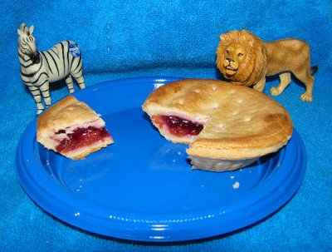
Performance Unpredicability
Resources are shared
How to guarantee performance isolation?

Slide 9
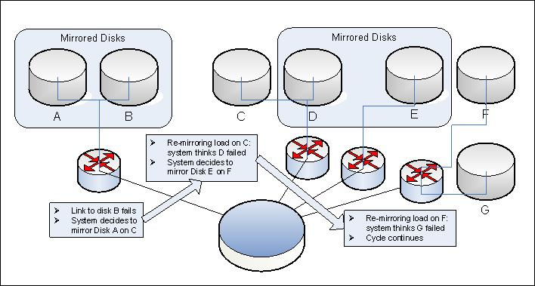
Reliability & Availability
Factors affecting reliability and availability
High number of components
Complexity: AWS outage

Slide 10
Security
Is security possible?
Microsoft Incident
Method: Password spraying on a legacy test account lacking MFA.
Impact: Accessed emails and documents of senior Microsoft executives and legal/security teams.
Duration: Undetected for nearly 2 months.
Response: Microsoft removed access and disclosed the breach in January 2024
https://msrc.microsoft.com/blog/2024/03/update-on-microsoft-actions-following-attack-by-nation-state-actor-midnight-blizzard/
Isolation of users
Legal and process issues
Physical security
Can we be secure if we are in same cloud as hacker? (Sony Incident)
Rented amazon EC2 servers
Mounted attack on Sony playstation network
Compromised 100 million user accounts
Notes:
LinkedIn – 2012 – more than 167 Million passwords and usernames were compromised.
Home Depot – 2014 – more than 56 Million credit card numbers stolen from homedepot point of sale terminals
Apple iCloud – personal storage compromised – 2017 - Turkish Crime Family – more than 250 million apple iPhones will be wiped out. (https://www.zdnet.com/article/icloud-accounts-breach-gets-bigger-here-is-what-we-know/)

Slide 11

Compliance
Is cloud provider complying with privacy rules?
Health care industry – requires health care compliance administrator
Sarbannes-Oxley -2002
Framed in 2002 after Enron, WorldCom financial accounting scandals
Example: Audit controls on transactions
India – SEBI Clause 49 (Corporate Governance Practices)
Notes:
https://www.investopedia.com/updates/enron-scandal-summary/

Slide 12
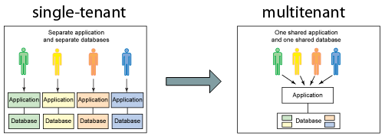
Multi-tenancy
Multi-tenancy
Sharing of same database by multiple users
Share without compromising security

Slide 13
Business Drivers of Cloud Computing

Slide 14
Potential benefits of Cloud Computing
Operational
Speed to Market
Scalability
Agility
Highly Automated
Flexibility
Financial
Pay per use
Lower Capital Investment
Reduced financial risk
Reduced Cost
Highly Automated
http://www.saasblogs.com/2008/12/01/demystifying-the-cloud-where-do-saas-paas-and-other-acronyms-fit-in/
21/08/2025
Notes:
14

Slide 15
Users
Public cloud
WAN connection
Enterprise

Slide 16
Inhibitors to adopting cloud computing
Security
Compliance
Interoperability and Vendor Lock-in

Slide 17
Deployment Models
Private Clouds
Built for a single enterprise
Community Clouds
Infrastructure shared by a community
Public Cloud
Owned by a service provider, both public and commercial are serviced
Hybrid Cloud
Mix of the above

Slide 18
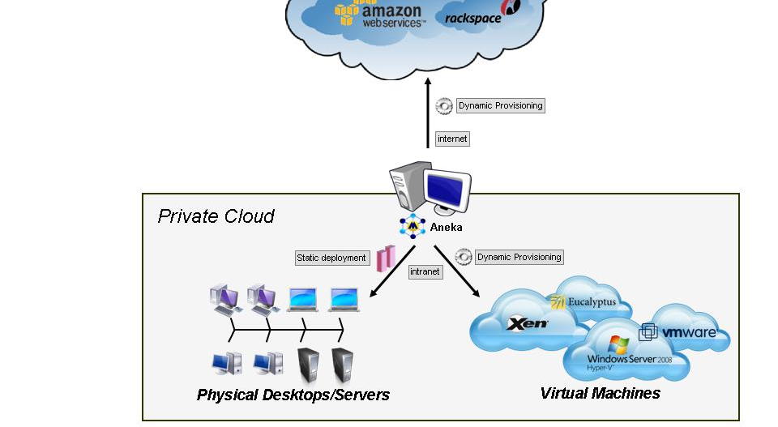
Public v/s Private Cloud architectures

Slide 19
Comparison of public vs private cloud
Private cloud needs H/W, S/W and Service (maintenance) costs
Public cloud has service fee
Public cloud also has WAN costs
Legal issues – 3rd party involvement in proceedings

Slide 20
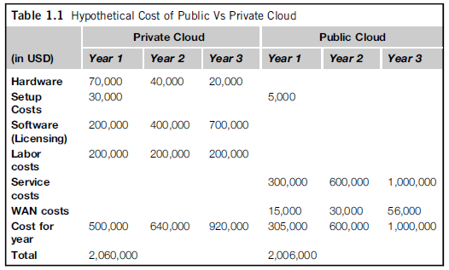
Comparison of public vs private cloud

Slide 21
Class Exercise (5 mins)
You are the software architect for a very successful product that has been in the market for more than 15 years. Your company has decided to move your application to the cloud ASAP
Would you use a private cloud or a public cloud?

Slide 22

Exercise 1
Your start a company BookKarts to sell books. You will accept orders from customers to select books and then dispatch the books to the customers after receiving payment.
Answer the question:
What components do I need to build?
Select the technologies for each component.
Work in your teams and present the solution after 10 mins

Slide 23
Exercises
Will the exercise given earlier be deployed in a public or a private cloud?
What about BookKarts– will this be stored on a cloud as well

Slide 24
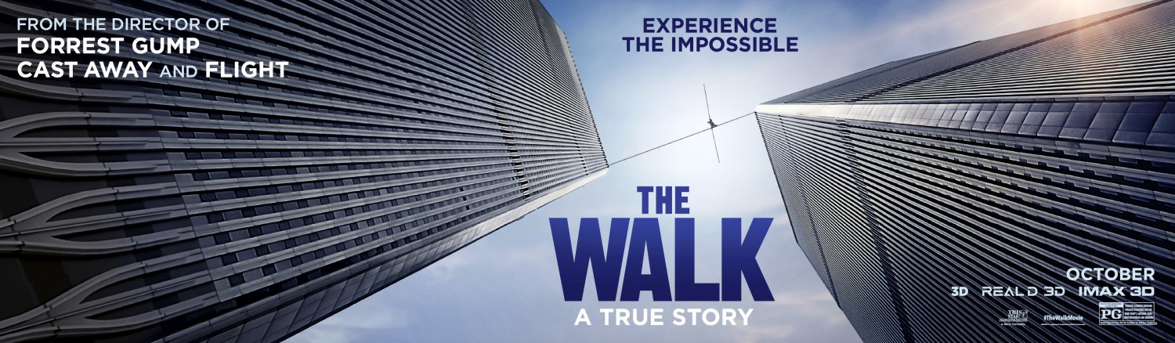
Assignment
What is the significance of the background in this slide to cloud computing?
Watch the video - https://www.youtube.com/watch?v=b6CGqA5R7QA The cloud imperative - Michael Crandell, Rightscale
Team composition due by Saturday.

